Slide 1



Kinematics of galaxies at intermediate redshift
Wilfried Mercier
IRAP – Toulouse, France
With contributions from:
T. Contini (IRAP), B. Epinat (LAM), N. Bouché (CRAL), A. Guérou (IRAP/ESO), D. Krajnovic (AIP), V. Abril-Megalejo (LAM), R. Bacon (CRAL)
& the MUSE-GTO team

Slide 2
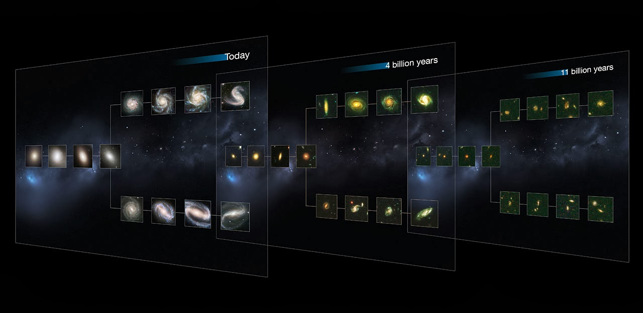
How did galaxies grow over time?
CANDELS
Now
z = 0
4 Gyr ago
z = 0.5
10 Gyr ago
z = 3
credits CANDELS
Cosmic Time

Slide 3
Why galaxy kinematics can help?
Main drivers of disc formation and settling?
(Re)distribution of angular momentum?
Dark Matter vs. Baryons?
Link with morphology, SFR, mergers, gas flows & gas fractions
Harrison+Swinbank17

Slide 4
Kinematics: how?
Based on bright rest-frame optical emission lines, mainly Hα, [OIII], [OII] → ionized gas
Extract maps of line flux, rotation (centroïd) and dispersion (width) velocity
PSF (beam smearing) has to be taken into account carefully
Main outputs: Maximum rotation velocity and dispersion velocity + characterization of instabilities (eg. mergers signatures)
Need for ancillary data, especially high-resolution images (eg. HST), and modeling

Slide 5
Velocity Fields Modeling
1D or 2D fitting
Assuming potential-well from mass distribution (eg. Genzel+08, Förster-Schreiber+09, Gnerucci+11, Wisnioski+15, Swinbank+17)
Fixed function (arctan, etc) to reproduce flattening of rotation curves (eg. Epinat+12, Swinbank+12, Stott+16, Contini+16, Harrison+17)
3D fitting: useful for faint and/or compact galaxies
GALPAK^{3D} (Bouché+15)
^{3D}BAROLO (Di Teodoro+Fraternali15)

Slide 6
Application to MUSE (deep) Fields
HDF-S: 27 hours
HUDF: 9 x 10 hours + 30 hours
PSF FWHM ~ 0.65’’
F_{lim} ~ 10⁻¹⁹ erg s⁻¹ cm⁻²
Bacon+15
Bacon+17, Inami+17
Contini+16
Contini+, in prep.

